Slide 1
From Linear to Circular

Slide 2
01
Food waste
02
What is the challenge?
03
From linear to circular food systems
Orange juice supply chain
Tomato sauce supply chain

Slide 3
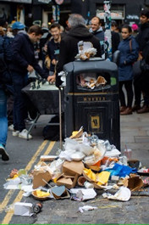
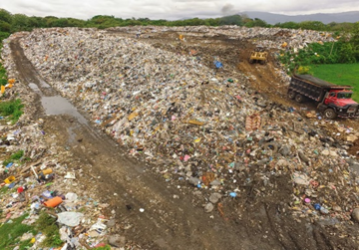
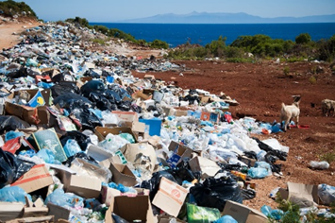
Food Waste
Video: SavingFood Educational on Food Waste
Source (photo): Unsplash
Source (photo): Unsplash
Source (photo): Unsplash

Slide 4
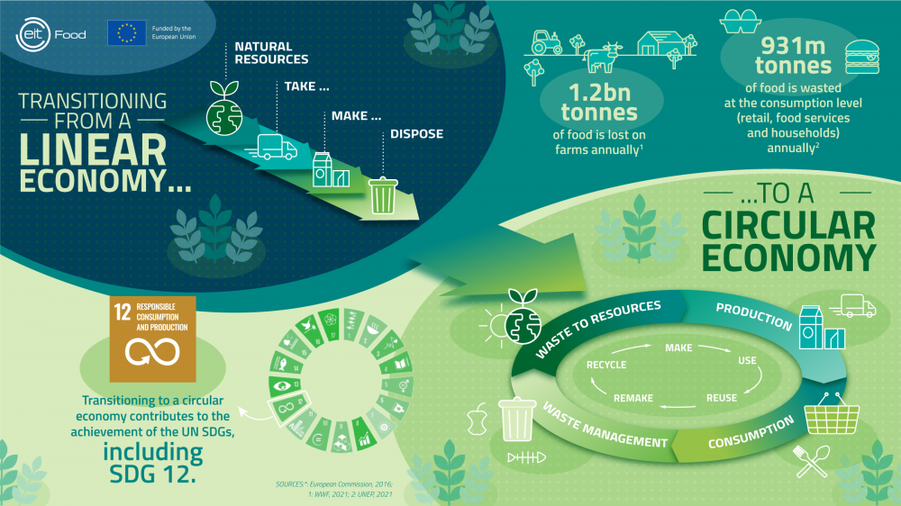
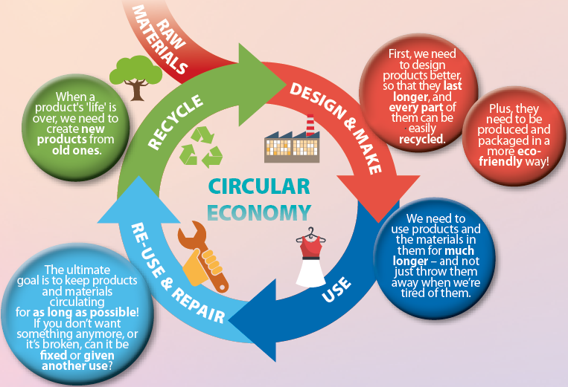
What is the challenge?
Source: National Geographic Kids https://www.natgeokids.com/uk/discover/science/general-science/all-about-the-circular-economy/
Video 1: https://www.youtube.com/watch?v=irThrRZdT5o&t=1s
Video 2: https://www.youtube.com/watch?v=zCRKvDyyHmI

Slide 5
From linear to circular food systems
AT THE FARM / PROCESSING INDUSTRY
Waste | What can be done?
Wheat organic waste | Added back to the soil as fertiliser
Maize cobs | Used as feed ingredient (low value solution)
Rice hull | Used as animal feed (low value solution)
Cattle manure | Fertiliser of the soil
Tomato seeds /peels | Animal feed/fertiliser back in the soil
Waste | What can be done?
Olive pomace (from olive oil production) | Can be used to make a food antioxidant (https://www.eitfood.eu/projects/phenoliva)
Apple pomace | Extraction of pectin
Apple orchard waste | Biofuel, source of natural antioxidants for the food industry
Source: Characterization of Agricultural Waste Co- and By-Products. Agrocycle Project (2016)

Slide 6
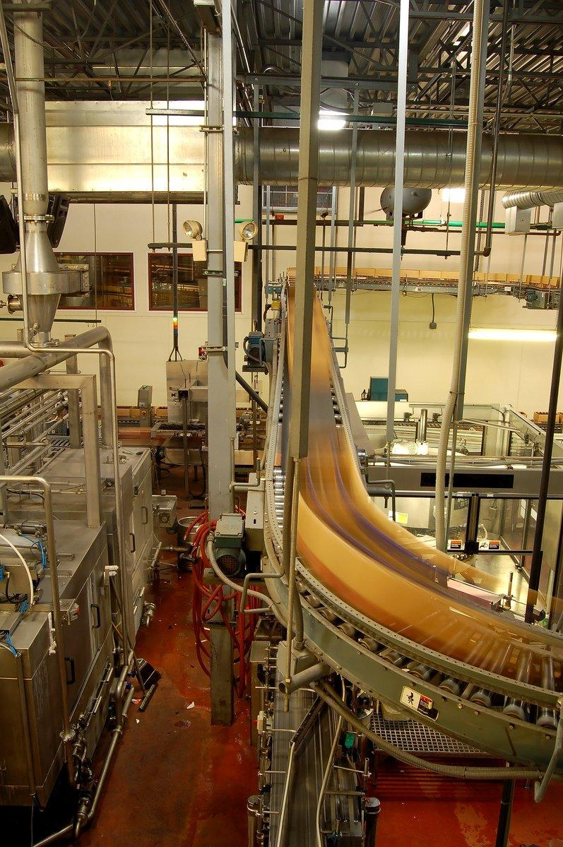
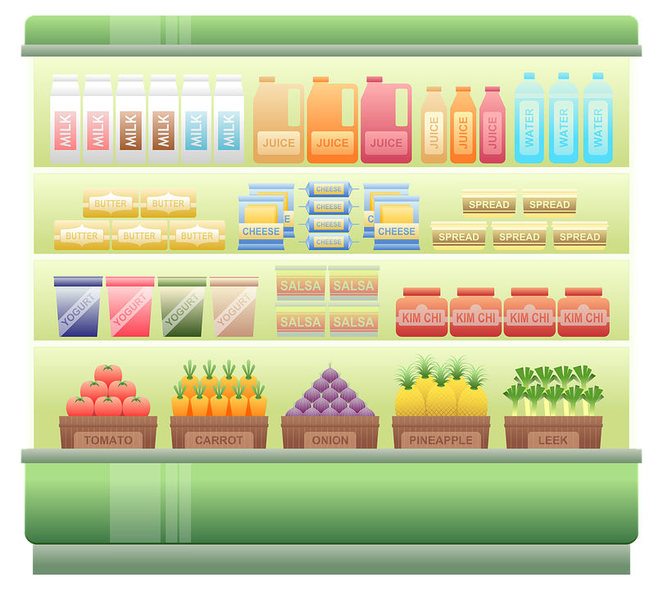
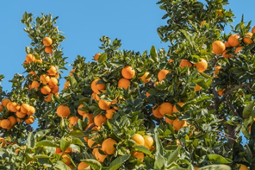
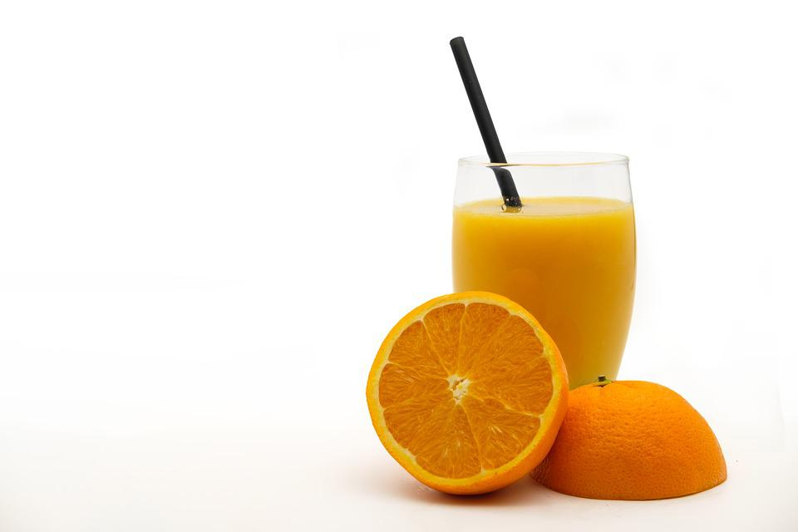
From linear to circular food systems: Orange juice supply chain (1)
Source (photo): Unsplash
Source (photo): Free Images
Source (photo): Pixabay
Source (photo): Pixabay
Orange producer
Orange processor to produce orange juice
Retailer
Consumer (house, restaurant)
Little waste (e.g., prunings)
WASTE (pulp, peel, damaged oranges, orange processing wastewater)
WASTE (Expired, problematic packages)
WASTE (Expired product, packaging)

Slide 7
From linear to circular food systems: Orange juice supply chain (2)
Other creative solutions / products: e.g., using orange peels to make fabric or biodegradable alternative to plastic (https://orangefiber.it/, https://www.pantografomagazine.com/en/circular-economy-orange-juice-format/, https://www.climate-kic.org/community/sevilla-neb-festival-remonda/ )
E.g., extraction of essential oils, pectin, soluble fibre, etc. (high value products)
Source (photo): Free Images
Composting (fertiliser)
Orange processor to produce orange juice
Animal feed
Composting (fertiliser)
WASTE
1. pulp
2. peel
3. damaged oranges
4. orange processing wastewater
treatment

Slide 8
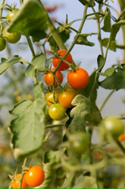
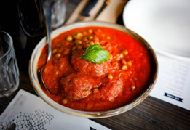
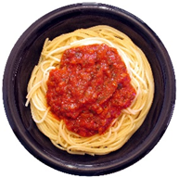
Tomato sauce supply chain: How can we close the loops?
Source (photo): Unsplash
Source (photo): Unsplash
Source (photo): Free Images
Tomato processor to produce tomato sauce
Source (photo): Pixabay
Retailer
Consumer (e.g., house/restaurant)
Tomato producer
1
2
3
4
WASTE (Plant parts we do not eat/want anymore)
WASTE (Peels, damaged, unripe tomatoes)
WASTE (Expired product, packaging)
WASTE (Expired, problematic packages)

Slide 9


Q&A
Follow us on

Slide 10
Thank you!

